Slide 1



HEALTH RECORDS CAPSTONE PROJECT
View in Power BI
Last data refresh:
12/11/2025 3:48:56 PM UTC
Downloaded at:
12/11/2025 3:54:56 PM UTC

Slide 2
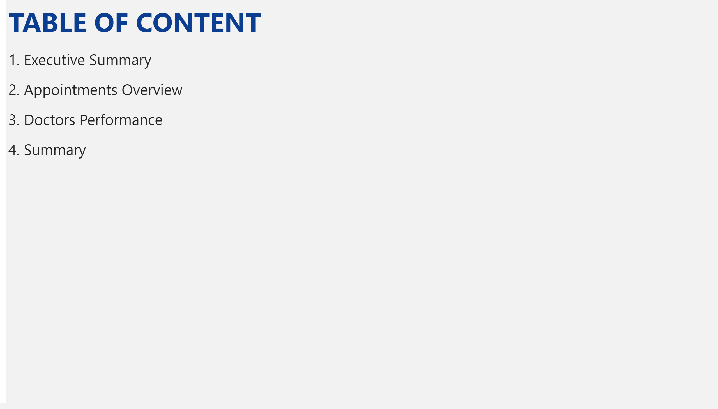
TABLE OF CONTENTS
Notes:
textbox
No alt text provided

Slide 3
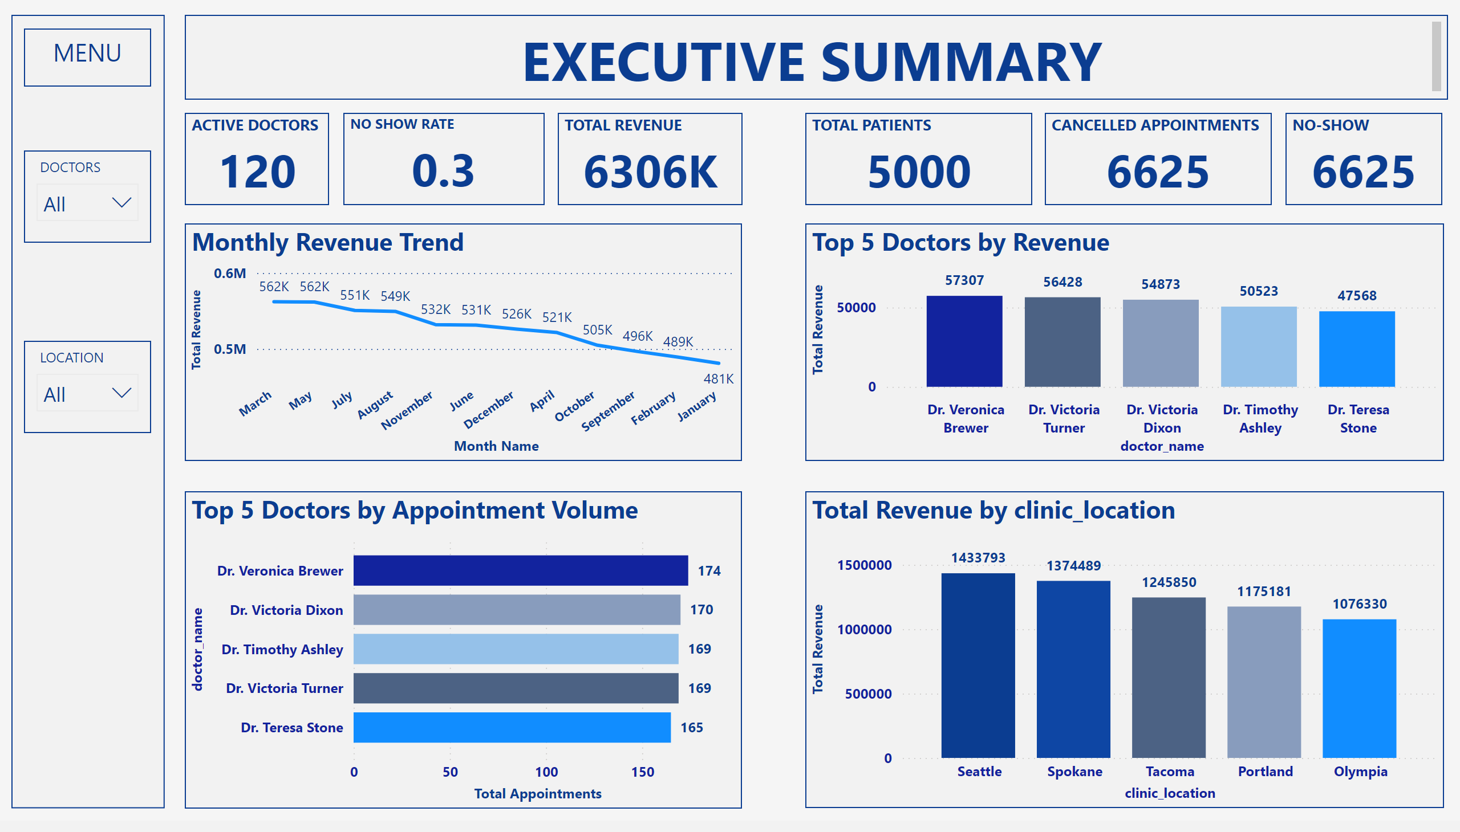
EXECUTIVE SUMMARY
Notes:
slicer
No alt text provided
textbox
No alt text provided
Top 5 Doctors by Appointment Volume
No alt text provided
slicer
No alt text provided
Monthly Revenue Trend
No alt text provided
textbox
No alt text provided
columnChart
No alt text provided
TOTAL REVENUE
No alt text provided
shape
No alt text provided
Top 5 Doctors by Revenue
No alt text provided
TOTAL PATIENTS
No alt text provided
CANCELLED APPOINTMENTS
No alt text provided
NO SHOW RATE
No alt text provided
ACTIVE DOCTORS
No alt text provided
NO-SHOW
No alt text provided

Slide 4
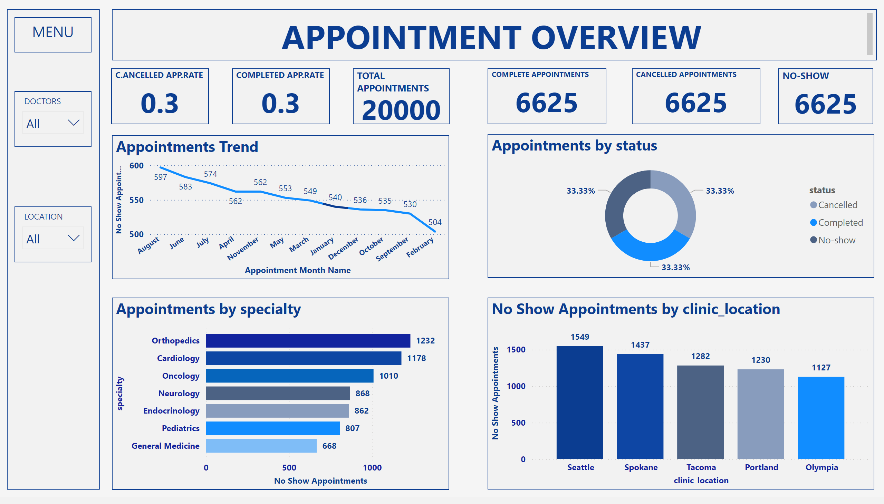
APPOINTMENT OVERVIEW
Notes:
Appointments by specialty
No alt text provided
COMPLETED APP.RATE
No alt text provided
textbox
No alt text provided
slicer
No alt text provided
CANCELLED APPOINTMENTS
No alt text provided
NO-SHOW
No alt text provided
columnChart
No alt text provided
slicer
No alt text provided
C.ANCELLED APP.RATE
No alt text provided
Appointments by status
No alt text provided
shape
No alt text provided
COMPLETE APPOINTMENTS
No alt text provided
textbox
No alt text provided
Appointments Trend
No alt text provided
TOTAL APPOINTMENTS
No alt text provided

Slide 5
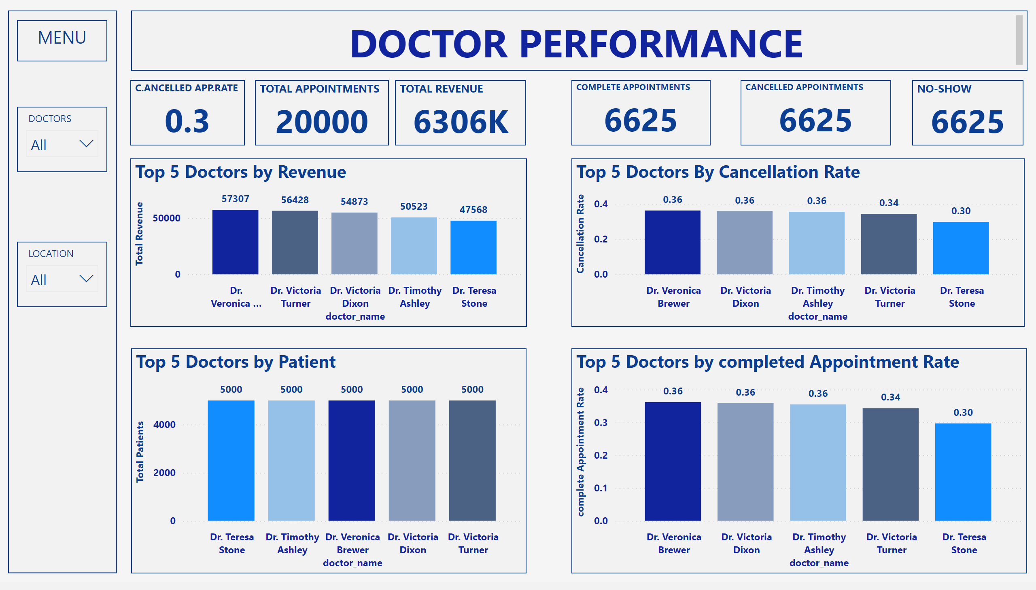
DOCTORS PERFORMANCE
Notes:
TOTAL APPOINTMENTS
No alt text provided
textbox
No alt text provided
TOTAL REVENUE
No alt text provided
slicer
No alt text provided
Top 5 Doctors by Revenue
No alt text provided
NO-SHOW
No alt text provided
COMPLETE APPOINTMENTS
No alt text provided
Top 5 Doctors by Patient
No alt text provided
C.ANCELLED APP.RATE
No alt text provided
textbox
No alt text provided
Top 5 Doctors by completed Appointment Rate
No alt text provided
CANCELLED APPOINTMENTS
No alt text provided
shape
No alt text provided
slicer
No alt text provided
Top 5 Doctors By Cancellation Rate
No alt text provided

Slide 6
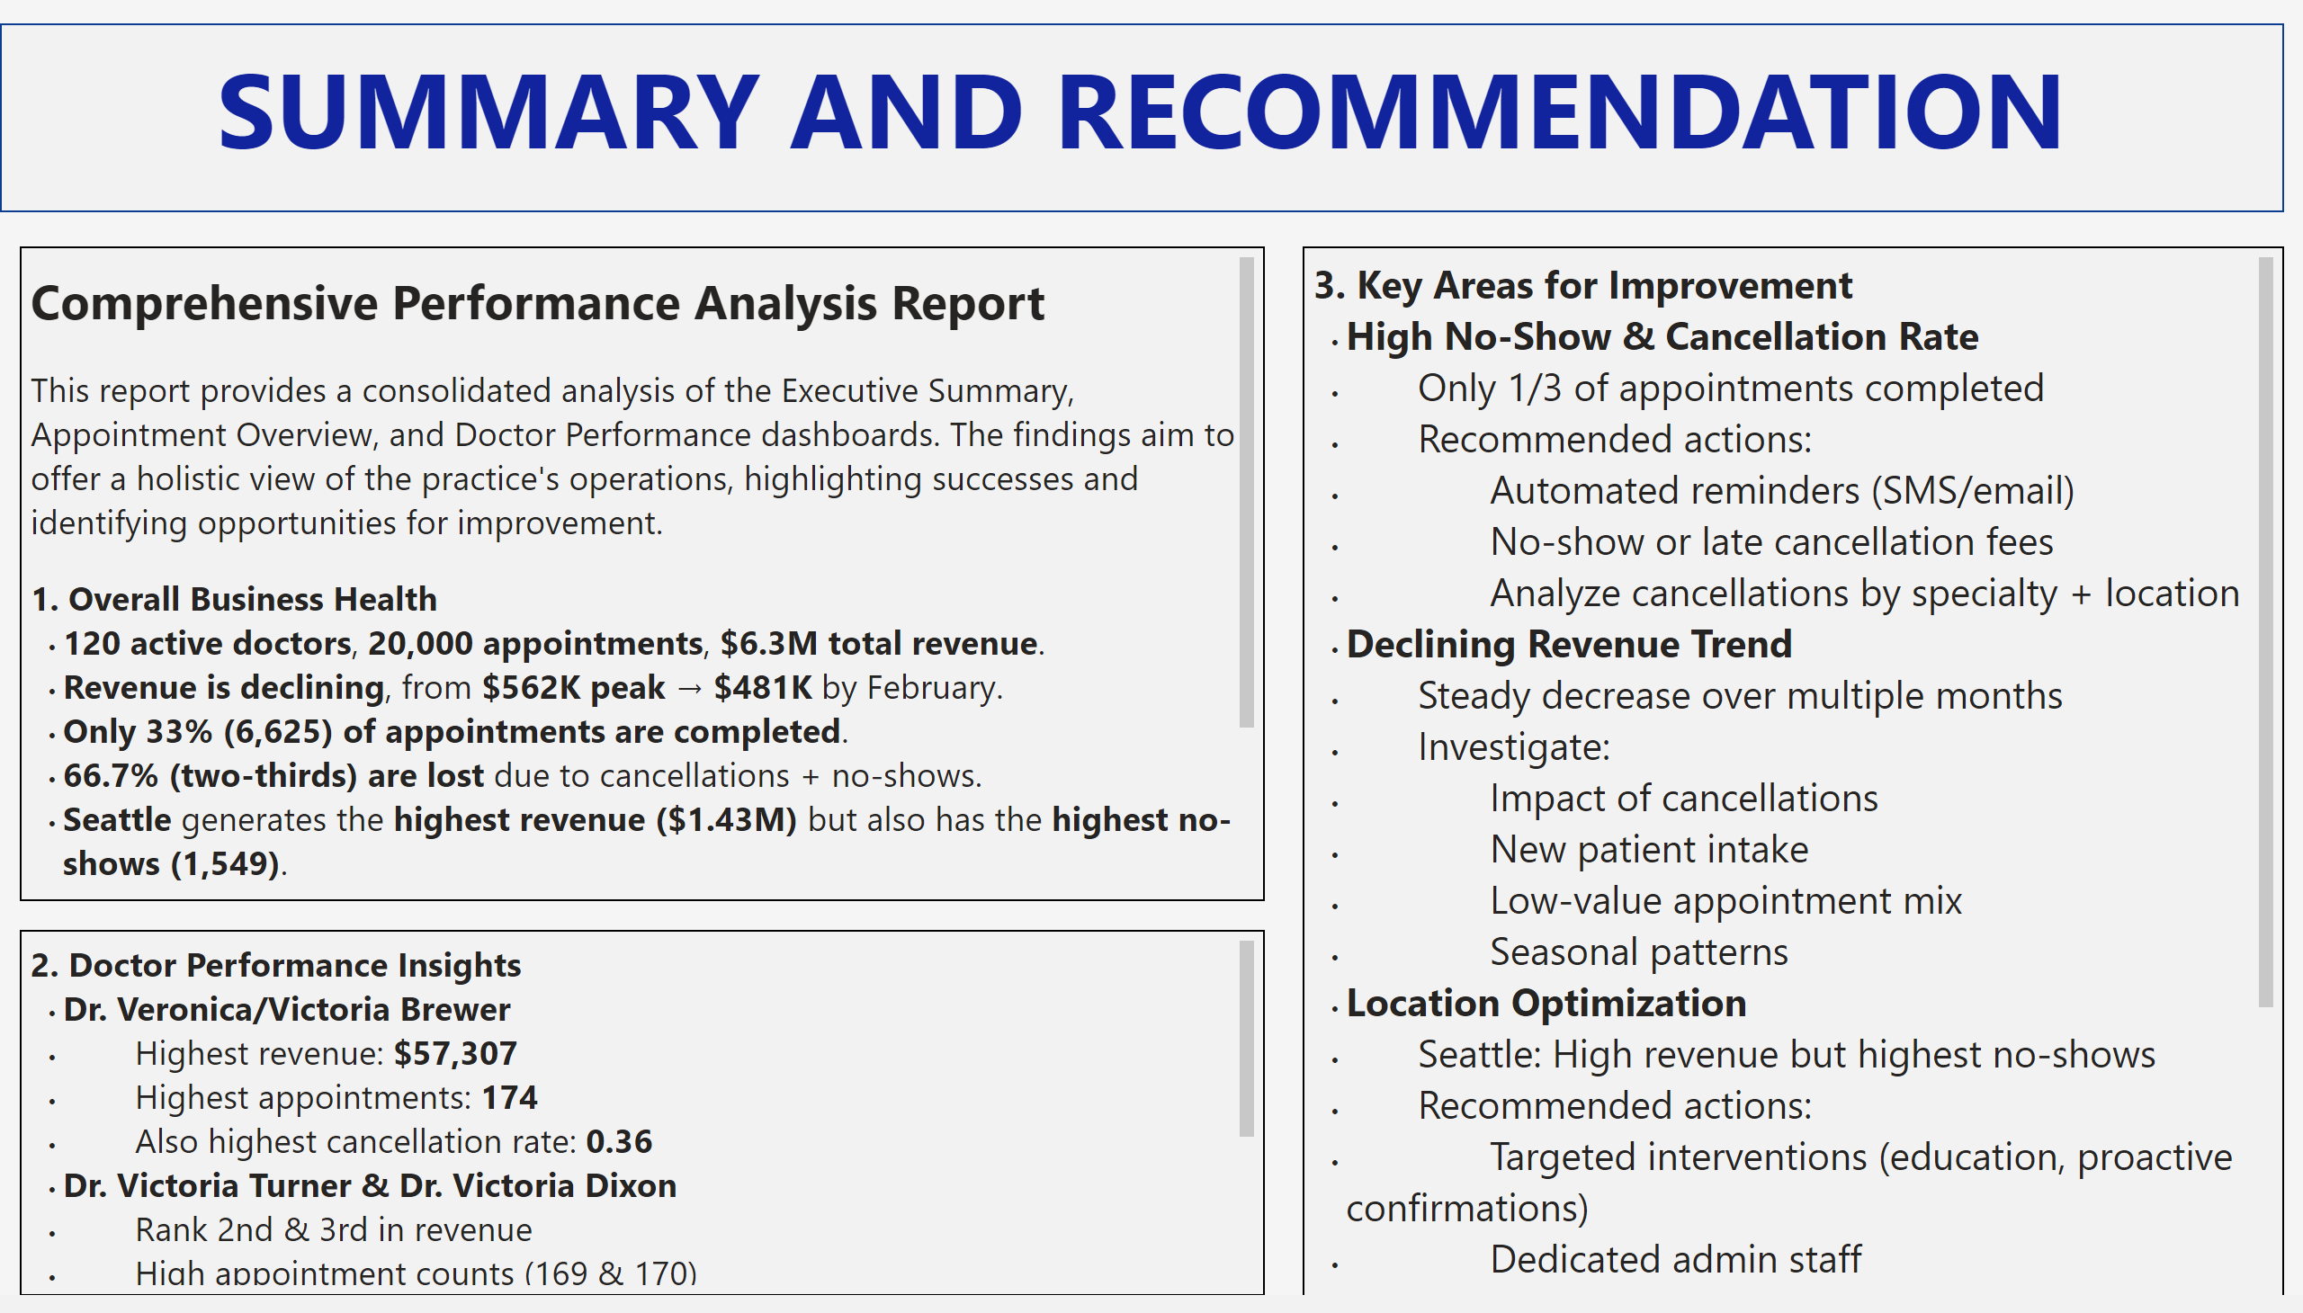
SUMMARY
Notes:
textbox
No alt text provided
textbox
No alt text provided
textbox
No alt text provided
textbox
No alt text provided

Slide 7
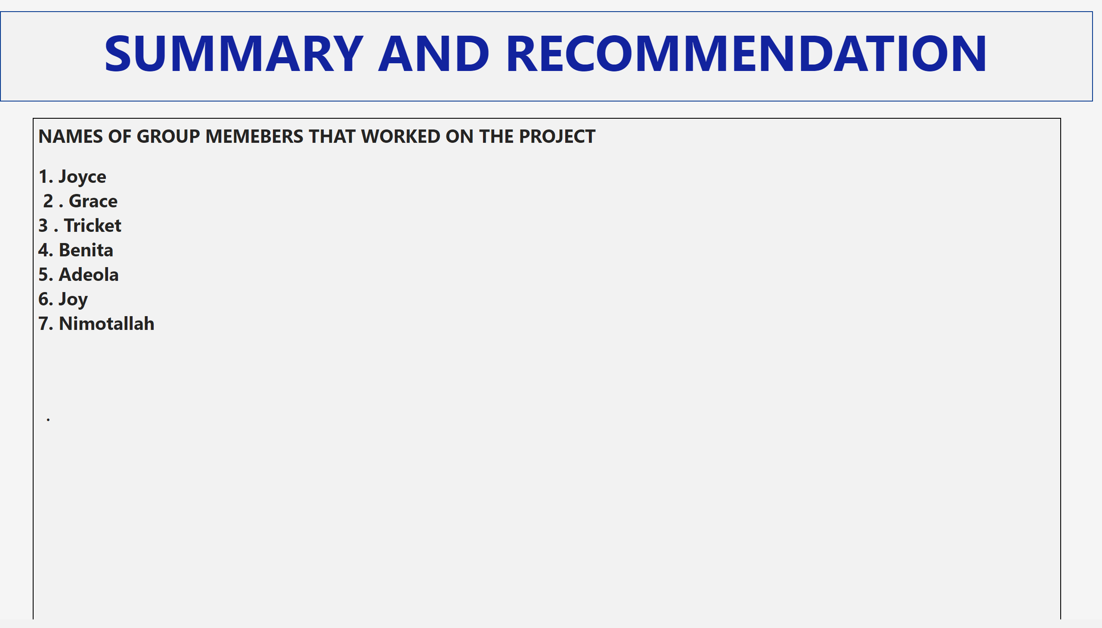
ATTENDANCE
Notes:
textbox
No alt text provided
textbox
No alt text provided

